Slide 1
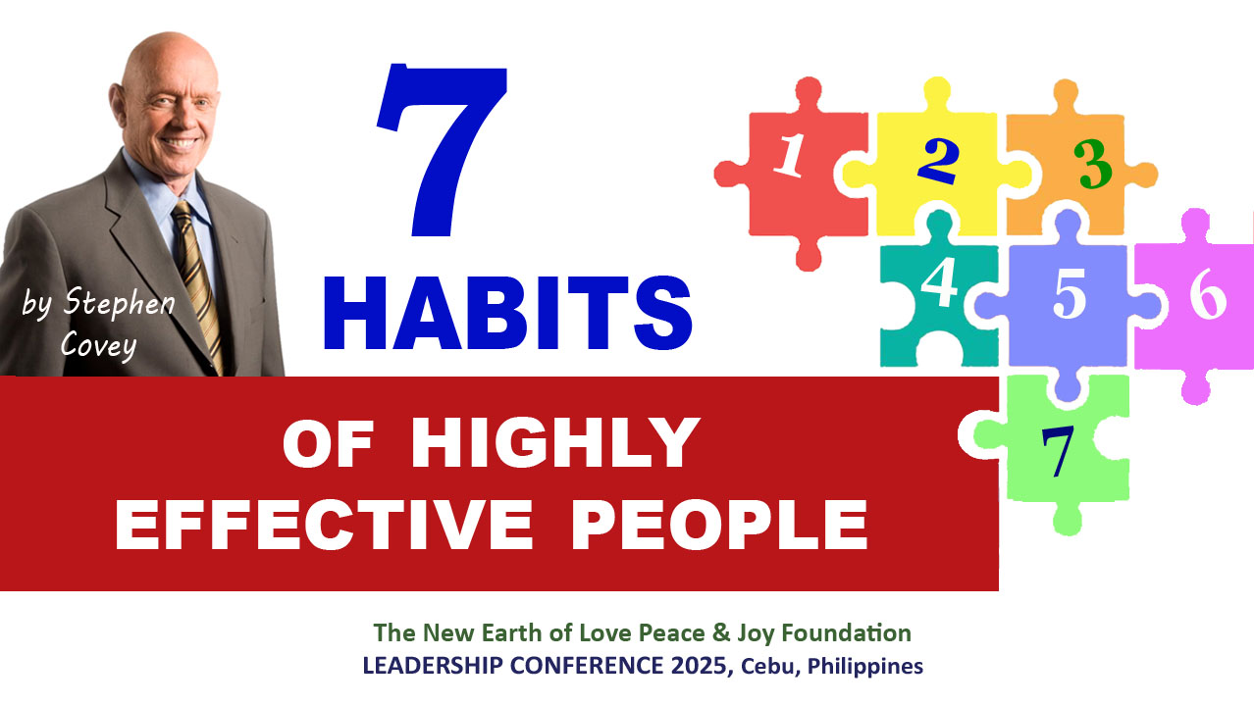

Slide 2


Slide 3
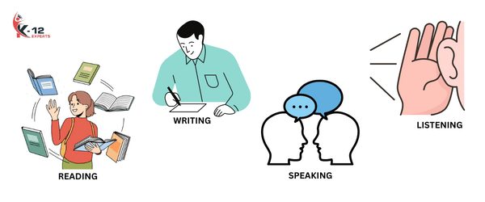
COMMUNICATION is the most important skill in life.
We spend most of our waking hours communicating –
Reading
Writing
Speaking
Listening
These are the 4 Basic types of Communication.

Slide 4
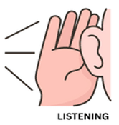
But consider this:
We spend years learning how to read, write, and speak. BUT WHAT ABOUT LISTENING?
Have we trained ourselves or did anybody teach us to LISTEN so that we really, deeply understand others?
Habit 5: Seek first to understand, then to be understood
is about LISTENING BEFORE WE SPEAK.

Slide 5
LISTENING IS THE BEGINNING OF UNDERSTANDING
Listening is to deeply understand another human being from that individual’s own frame of reference.
“But unless I open up with you, unless you understand me and my unique situation and feeling, you won’t know how to advise or counsel me. What you say is good and fine, but it does not really help me.”
“You may say you care about and appreciate me… But how can you appreciate me when you don’t even understand me? All I have are your words, and I can’t trust words.”
“Unless you acknowledge my uniqueness, I’m not going to be influenced by your advice.”

Slide 6
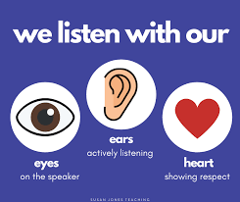
IF YOU WANT TO INTERACT EFFECTIVELY WITH SOMEONE – your spouse, child, neighbor, boss, coworker, friend - you need to understand them first. That is through EMPHATIC LISTENING.
Empathic (from empathy) listening means entering the other person’s world… seeing the world the way they see the world, understanding their thoughts, perspective and feelings.
It means not just listening with your ears, but more importantly with your eyes and your heart.
You listen for feeling, for meaning, for behavior.
This will help us understand the underlying issues.

Slide 7
When a person speaks, we are usually “listening” at one of four levels.
1. Ignoring another person, not really listening at all.
2. Pretending. “Yeah. Uh-huh. Right.”
Selective listening, hearing only certain parts of the
conversation.
Attentive listening, paying attention and focusing energy on the words that are being said.

Slide 8

But very few of us ever practice this 5th level, the highest form of listening,
which is EMPATHIC LISTENING.
That is, listening with intent to
understand, to really understand
from the other person’s point of
view.
This creates openness, trust, and confidence.

Slide 9
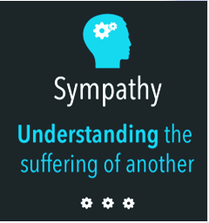
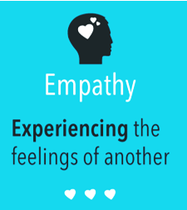

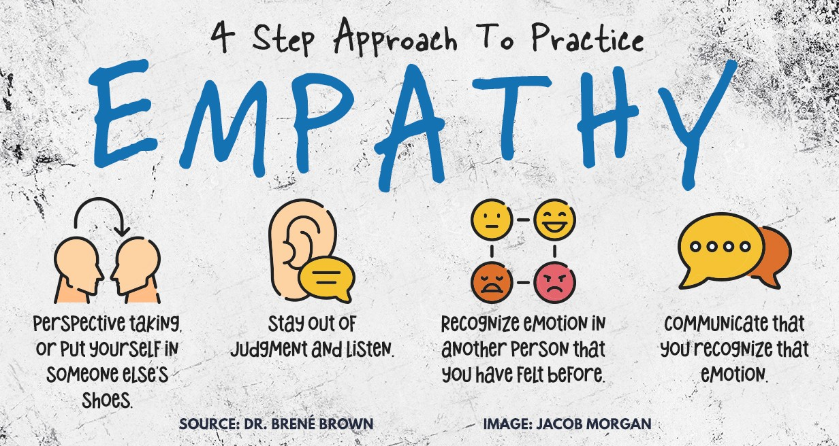
Sympathy vs. Empathy
Sympathy is feeling sorry for someone
else’s misfortune
Empathy is understanding and sharing their feelings

Slide 10
I. Seek first to understand…. (through EMPHATIC LISTENING)
“Seek first to understand” involves a very deep shift in paradigm because we normally seek first to be understood.
Most people do not listen with the intent to understand; they listen WITH THE INTENT TO REPLY. They’re either speaking or preparing to speak.
They’re filtering everything through their own paradigms, reading their autobiography into other people’s lives.
“Oh, I know exactly how you feel!”
“I went through the very same thing. Let me tell you about my experience.”
If they have a problem with someone, their attitude is, “That person just doesn’t understand.”

Slide 11
As told by Stephen Covey:
A father once told me, “I can’t understand my kid. He just won’t listen to me at all.”
“Let me restate what you just said,” I replied. “You don’t understand your son because he won’t listen to you?”
“That’s right,” he replied.
“Let me try again,” I said. “You don’t understand your son because he won’t listen to you?”
“That’s what I said,” he impatiently replied.
“I thought that to understand another person, you needed to listen to him,” I suggested.
“Oh!” he said. There was a long pause. “Oh!” he said again, as the light began to dawn.

Slide 12

“Oh, yeah! But I do understand him. I know what he’s going through. I went through the same thing myself. I guess what I don’t understand is why he won’t listen to me.”
This man didn’t have the slightest idea of what was really going on inside his son’s head. He looked into his own head and thought he saw the world, including his son.
That’s the case with so many of us. We’re filled with our own rightness, our own autobiography.
We want to be understood… and we never really understand what’s going on inside another human being.

Slide 13
Emphatic Listening vs. Reactive Listening
Emphatic Listening means listening with empathy and understanding another person's perspective.
Reactive Listening means listening with the intent to reply, refuting the speaker's points, or imposing their own opinion, rather than genuinely understanding the speaker's message or feelings. It involves listening with the intent to reply, interpret, or advise, often leading to interrupted conversations, judgment, and a lack of connection or empathy.

Slide 14
The essence of emphatic listening is not that you agree with someone; it’s that you fully, deeply, understand that person emotionally as well as intellectually.
TYPES OF EMPHATIC RESPONSES
1. Mimicking
2. Rephrasing
3. Reflect feeling
4. Rephrase content and reflect feeling
5. Say nothing

Slide 15
Mimicking (repeating words)
Example: a son telling her mother that does not want to go to school anymore
“Ma, para lang sa mga genius at matatalino ang school.”
“Ganun ba anak, para lang sa mga genius at matatalino ang school.”
By just mimicking or repeating words, you haven’t evaluated or question or advised or interpreted. You’ve at least showed you’re listening and paying attention to his words.
But to understand, you want to do more.

Slide 16
The second stage of empathic listening is to rephrase the content. It’s a little more effective,
but it’s still limited to the verbal communication.
2. Rephrasing
“Ma, para lang sa mga genius at matatalino ang school.”
“So ayaw mong pumasok sa school, anak?”

Slide 17
In third stage, you’re paying attention to what he is feeling.
3. Reflect feeling
“Ma, para lang sa mga genius at matatalino ang school.”
“Nahihirapan ka mag-aral no..”
4. Rephrase content and reflect feeling
“Ma, para lang sa mga genius at matatalino ang school.”
“So ayaw mong pumasok sa school dahil nahihirapan ka mag-aral no..”

Slide 18

As you authentically seek to understand, as you rephrase content and reflect feeling, you give him psychological air. You also help him work through his own thoughts and feelings.
It opens a soul-to-soul flow. He begins to trust you with his innermost tender feelings and thoughts. He sees that you understand what he is feeling and that you are willing to help.

Slide 19

5. Say nothing.
Another type of emphatic response.
Sometimes people just need someone to listen.
It’s also better to be silent than say negative words.
THE BEST EMPHATIC RESPONSE DEPENDS ON THE SITUATION.
Empathic listening is a big deposit in the Emotional Bank Account.
It’s deeply therapeutic and healing because it gives a person “psychological air.”

Slide 20

Next to physical survival, the greatest
need of a human being is psychological
survival—to be understood, to be
affirmed, to be validated, to be
appreciated.
And after that important need is met, you can then focus on influencing or problem solving.
When he sensed that you understand and you care, he will open up, and possibly ask for your help and advice.

Slide 21
What a difference real understanding can make!
The key is to genuinely seek the welfare of the individual, to listen with empathy, to let the person get to the problem and the solution at his own pace and time. Layer upon layer—it’s like peeling an onion until you get to the soft inner core.
When people are really hurting and you really listen with a pure desire to understand, you’ll be amazed how fast they will open up. They want to open up. Children desperately want to open up, even more to their parents than to their peers. And they will, if they feel their parents will love them unconditionally and will be faithful to them afterwards and not judge or ridicule them.

Slide 22
II. THEN SEEK TO BE UNDERSTOOD
1) Seek first to understand… 2) then to be understood.
We define maturity as the balance between courage and consideration.
Seeking to understand requires consideration;
seeking to be understood takes courage.
In interdependent situations, both are needed –
to understand and to be understood-
in order to achieve WIN-WIN solution.

Slide 23

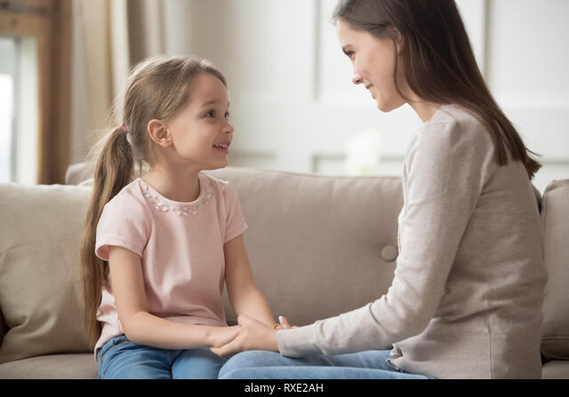

ONE-ON-ONE
The more deeply you understand other people, the more you appreciate them.
In your family, you can schedule a regular ONE-ON-ONE conversation with your spouse, son, or daughter. Same in business, have one-one talk with your employees. Listen to them, understand them.
Do it also with friends, and within your organization (like mentorship).

Slide 24


When you listen, you learn. You give them the psychological air.
When you really deeply understand each other, we open the door to creative solutions and third alternatives. Our differences are no longer stumbling block to communication and progress. Instead, this become the stepping stone to synergy (Habit 6).

Slide 25
